Slide 1


Slide 2
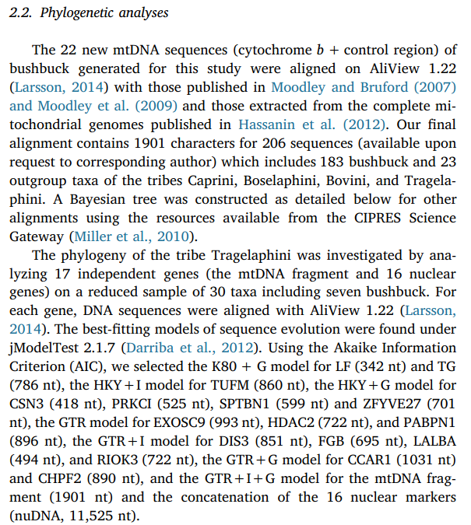

Slide 3
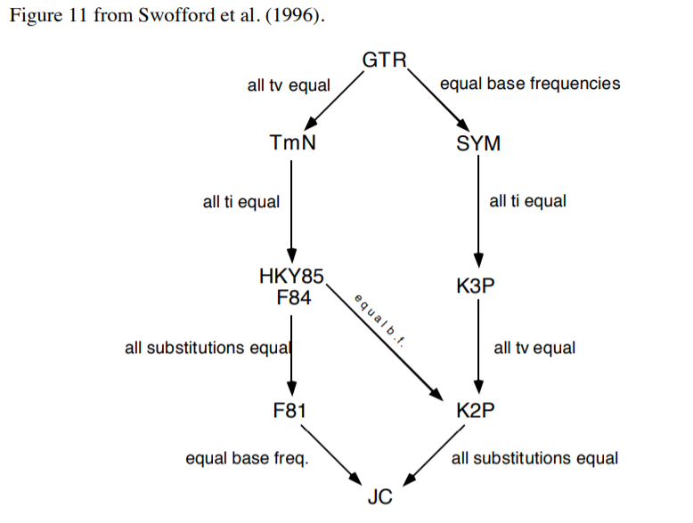

Slide 4
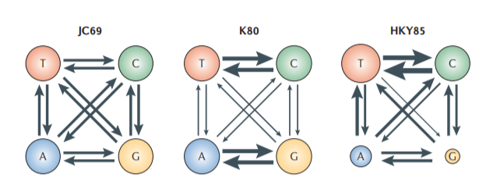
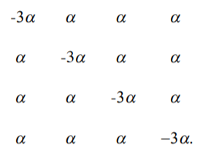
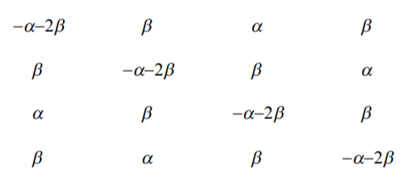
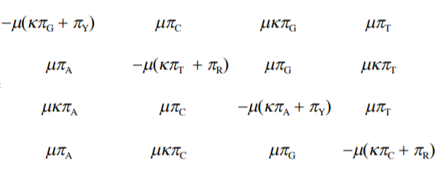

Slide 5
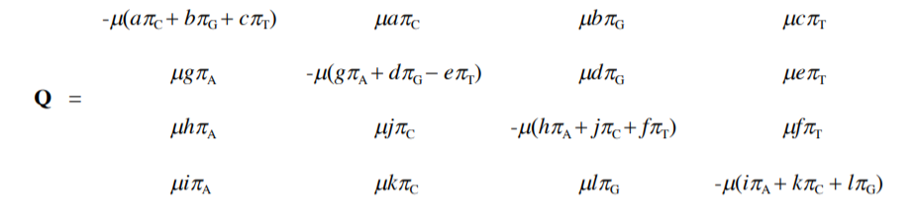
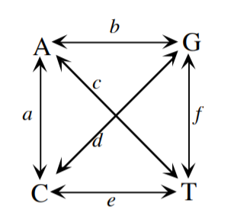
General Time-Reversible Model

Slide 6
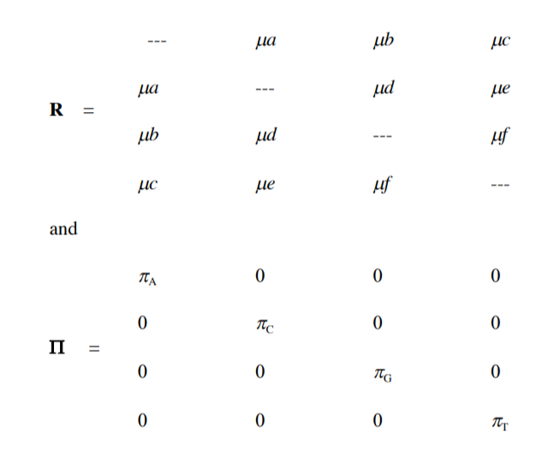
General Time-Reversible Model

Slide 7
Back to biology - Are JC69's assumptions realistic?
Assumptions of JC69:
1. All substitutions equally likely
2. Base frequencies equal
3. Every site has equal probability of substitution
4. Process is constant through time
5. Sites are independent of each other
6. Substitution is Markovian (memoryless)
7. All sites have the same evolutionary history
Can we relax any of these assumptions?

Slide 8
Among-site rate variation

Slide 9
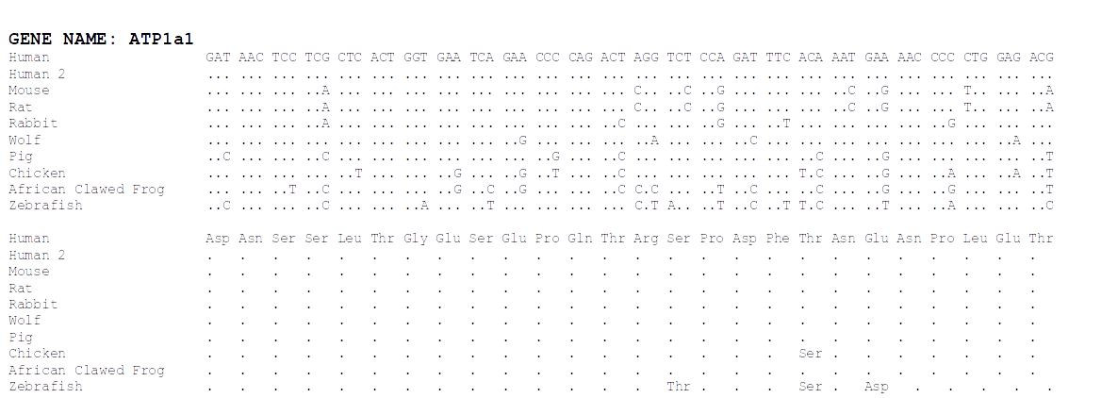
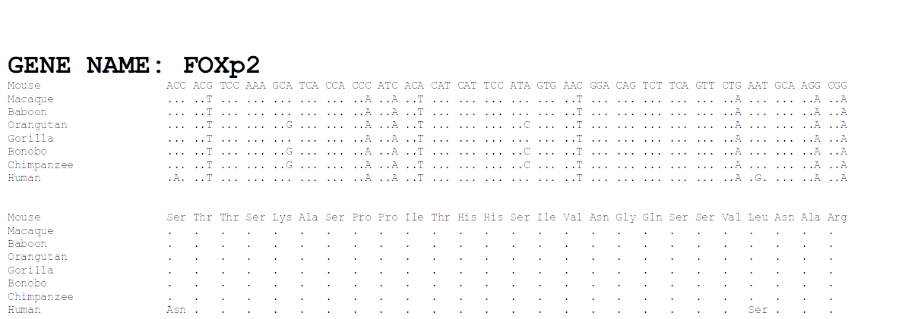

Slide 10
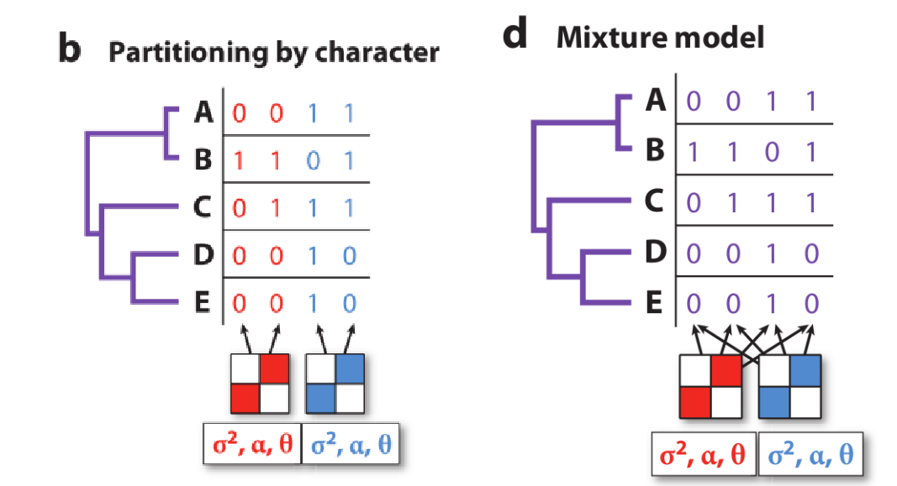
Two approaches to rate variation (often combined!)

Slide 11
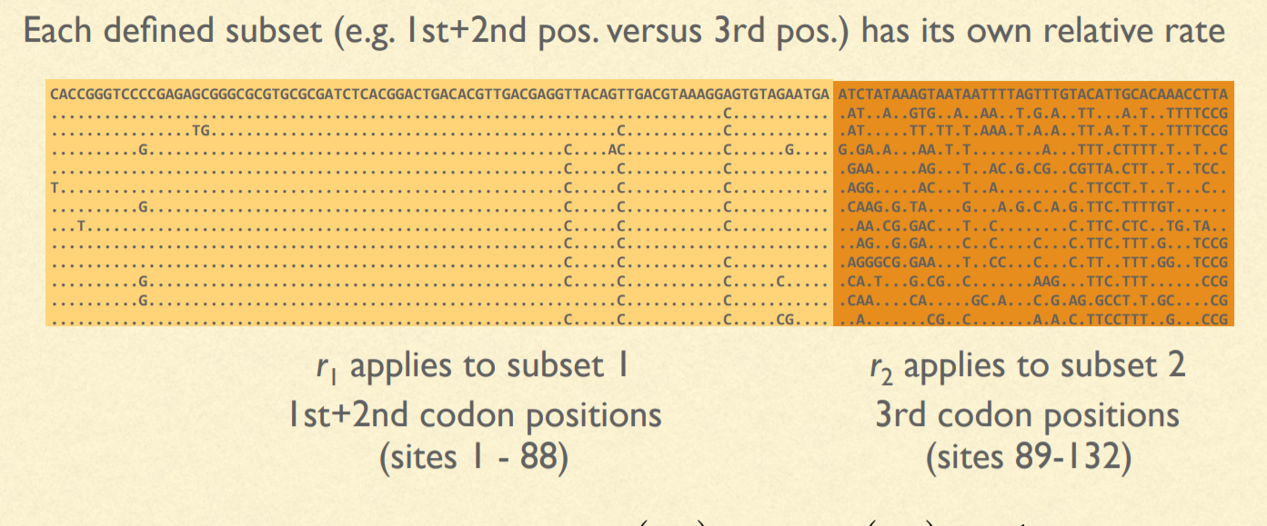
One solution: Pre-defined partitions

Slide 12


Slide 13


Slide 14
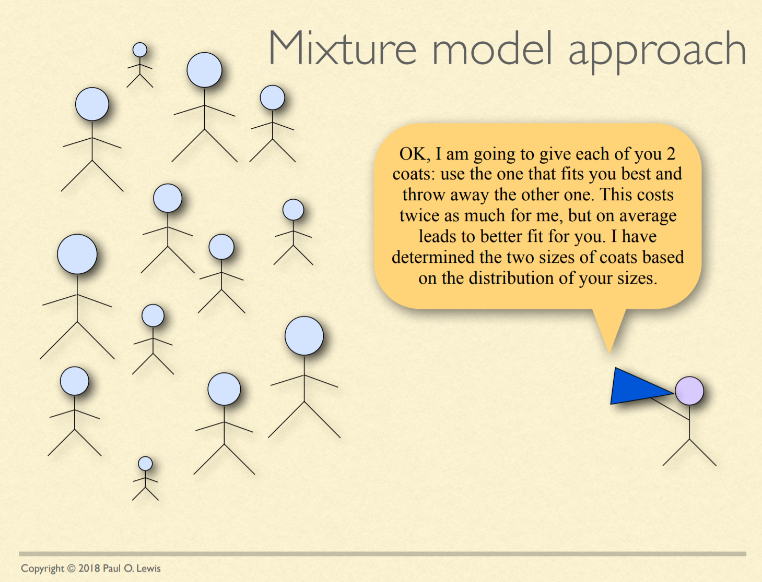

Slide 15
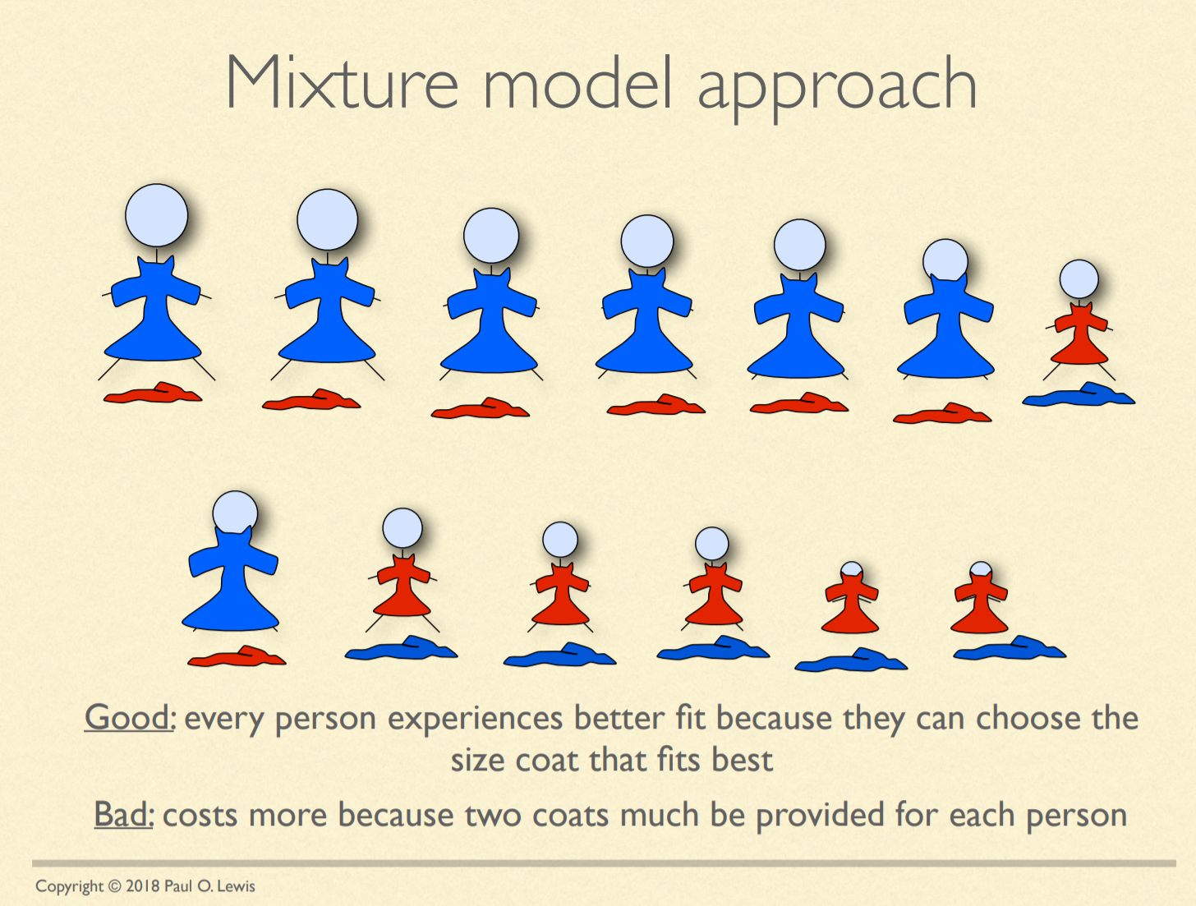

Slide 16
Invariable sites model
Every site has a probability, P_{invar} of being invariant
P_{invar} estimated from the data
Every site gets its likelihood estimated in two parts: If it were invariant & variable (as normal)
Often designated "+I" (e.g. HKY85 + I)

Slide 17
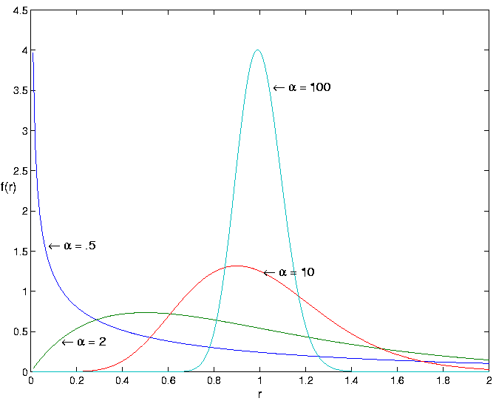
Gamma-distributed rates
Rate categories set by a discrete gamma distribution (e.g. 4 rate categories)
Estimate α
Site likelihoods calculated for each rate category and summed
" + G " or “ + Г ”
(e.g. HKY85 + I + G)

Slide 18
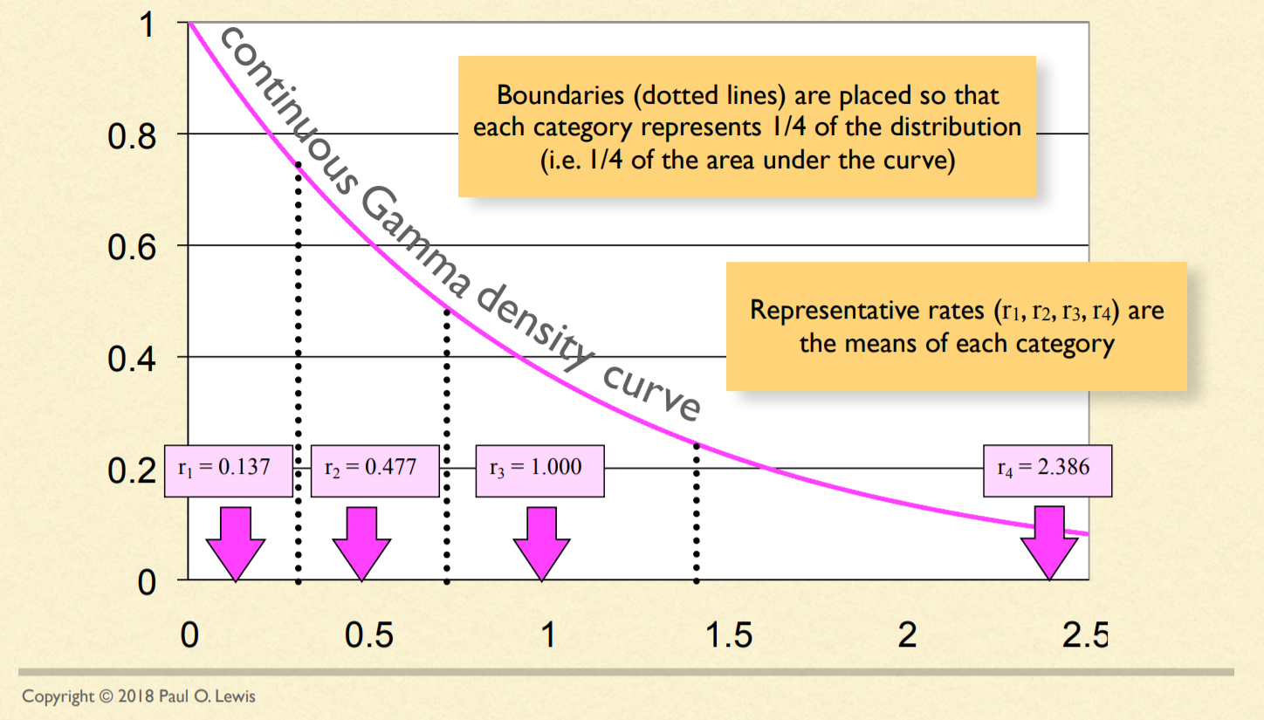
Discretizing the Gamma distribution

Slide 19
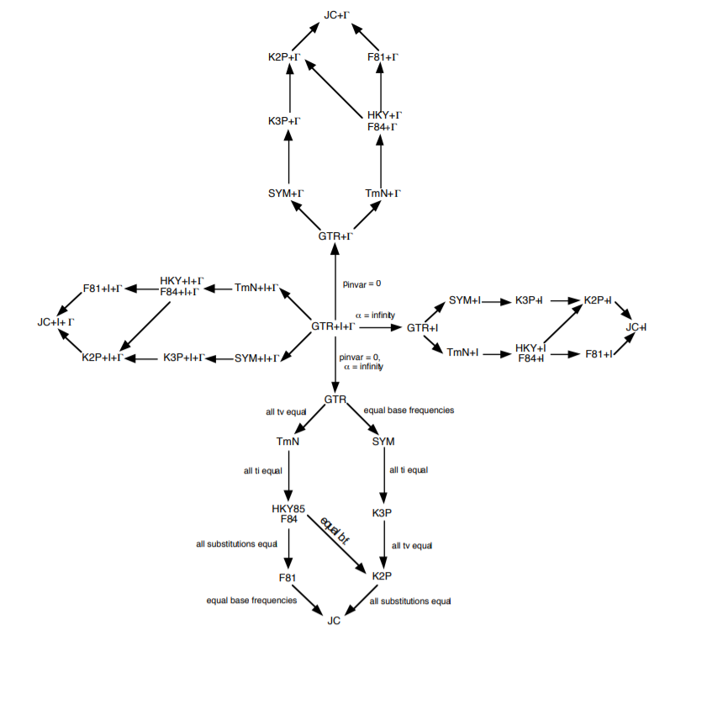
OK...but how do we decide which model to use?!?!

Slide 20
Model testing
Ideally, fit all models while simultaneously estimating tree
More practical:
Start with a not-too-bad tree, fit all the possible models, rank them by some criterion, pick the best one and use in a full analysis
Criteria: Likelihood ratio test, Akaike Information Criterion, Bayesian Information Criterion, Decision Theory, Bayesian model selection, Bayesian hypothesis testing or model averaging
- pick your favorite statistical philosophy!

